Slide 1




NFH (original); 31, 4
NFHD2; 40, 4
D2: delete 36-72
Rerun alg on D2
NFH (phos); 36, 4
NFHD2 (phos); 33, 4
Note: not currently doing this

Slide 2






Native NFH

Slide 3

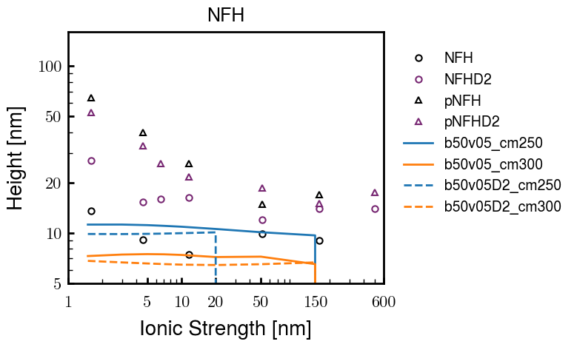


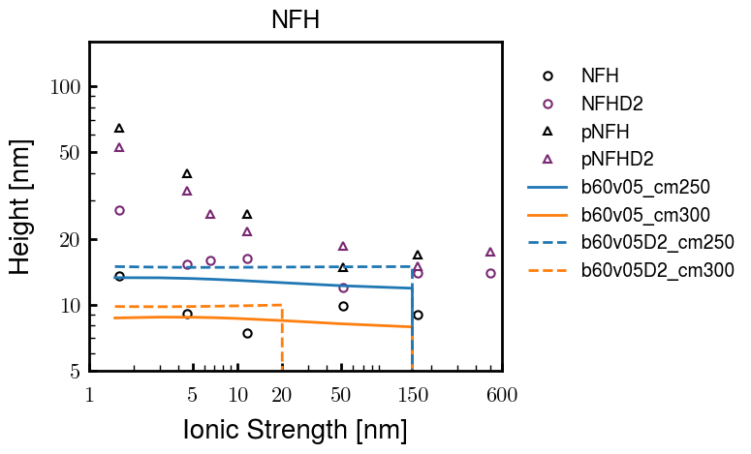

NFHD2

Slide 4
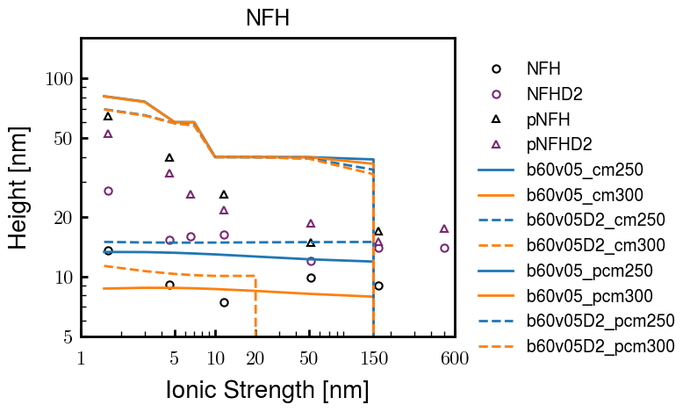
pNFH(D2)
Lx rerun

Slide 5



Slide 6



 | Slope Bins 4 | Smear Count 25
Block number | Alpha w/ Henderson Hasselbalch | Chi Chi_max = 2.2
[0 50] | 0.040012 | 1.160000
[50 75] | -0.278451 | 0.720000
[75 125] | -0.519707 | 0.608000
[125 156] | -0.154453 | 0.529032

Slide 7


 | Slope Bins 4 | Smear Count 31
Block number | Alpha w/ Henderson Hasselbalch | Chi Chi_max = 2.2
[0 31] | 0.001103 | 0.922581
[31 62] | -0.386873 | 0.703226
[62 93] | -0.290146 | 0.967742
[93 496] | 0.037164 | 1.098759
[496 527] | -0.064533 | 0.819355
[527 620] | 0.010682 | 0.756989
[620 647] | -0.103326 | 0.696296

Slide 8






Previous
New

Slide 9





Slide 10


Response to stimuli given composition
Same data
Effect of composition given environment

Slide 11


NFL, pH 7.44, phos 1.5e (locs from LCMS)
Non-phos NFL
Block number | Alpha w/ Henderson Hasselbalch | Chi Chi_max = 3.2
[0 50] | 0.040012 | 1.540000
[50 75] | -0.278451 | 0.960000
[75 125] | -0.519707 | 0.868000
[125 156] | -0.154453 | 0.690323
 | Slope Bins 4 | Smear Count 25
Block number | Alpha w/ Henderson Hasselbalch | Chi Chi_max = 3.2
[0 50] | -0.019988 | 1.540000
[50 75] | -0.278451 | 0.960000
[75 125] | -0.519707 | 0.868000
[125 156] | -0.154453 | 0.690323

Slide 12


NFM, pH 7.44, phos 1.5e (locs from LCMS)
 | Slope Bins 4 | Smear Count 32
Block number | Alpha w/ Henderson Hasselbalch | Chi Chi_max = 3.0
[0 32] | 0.079143 | 1.275000
[32 64] | -0.186340 | 1.125000
[64 96] | -0.327964 | 1.181250
[96 160] | -0.460694 | 0.787500
[160 224] | -0.124999 | 1.115625
[224 288] | -0.023510 | 0.956250
[288 352] | -0.242085 | 1.003125
[352 384] | -0.031302 | 1.125000
[384 416] | -0.123860 | 1.050000
[416 438] | 0.046945 | 1.281818

Slide 13





Bin 3 NFM, pH 7.44, phos 1.5e (locs from LCMS)

Slide 14




Bin 5 NFM, pH 7.44, phos 1.5e (locs from LCMS)

Slide 15



Phos 2 NFM, pH 7.44, phos 2.0e (locs from LCMS)

Slide 16



Chi 2.5 NFM, pH 7.44, phos 2.0e (locs from LCMS)

Slide 17



NFM, pH 7.44, non-phos

Slide 18


NFH, pH 7.44, phos 1.5e (locs from LCMS)
 | Slope Bins 4 | Smear Count 36
Block number | Alpha w/ Henderson Hasselbalch | Chi Chi_max = 3.2 | Chi Chi_max = 3.0
[0 36] | 0.000945 | 1.266667 | 1.20000
[36 72] | -0.527455 | 0.900000 | 0.85000
[72 324] | -0.208376 | 1.729365 | 1.628571
[324 396] | -0.111195 | 1.416667 | 1.333333
[396 432] | -0.152824 | 1.344444 | 1.266667
[432 647] | -0.033955 | 1.077209 | 1.015814

Slide 19




Phos block dashed
Phos block dashed

Slide 20



Best are b3.0 v2.0 and b3.0 v3.0, but max H not high enough
Possible solutions:
Lower chi_max
Change aa_disc to have more charge
Force spectra?
Better for low salt, but high salt will melt brushes together

Slide 21



M1
pMx5

Slide 22



b3.00; v1, 2
b4.00; v2, 2.5, 3, 5, 10
b5.00; v3, 10, 15, 40
53 Nk
39 Nk
32 Nk

Slide 23
Binary results

Slide 24



Matrix Approach
Updated 04/04/2023

Slide 25














H Vol decrease (by v)
H Vol decrease (by b)
Desired “linearity” by tuning /thresh/ based on polymer density of expelled NFL
L Vol decrease (by b)
Comes at severe cost of overall height. Have to minimize outer concentration to approach pure thresh of 1e-06

Slide 26














H Vol decrease (by v)
H Vol decrease (by b)
Chimax 3.5
Desired “linearity” by tuning /thresh/ based on polymer density of expelled NFL
L Vol decrease (by b)
Comes at severe cost of overall height. Have to minimize outer concentration to approach pure thresh of 1e-06

Slide 27








F (3.5)
Chimax 3.5
Chimax 3.0
Scaled by 1.5
Scaled by 1.6
Scaled by 1.6
Scaled by 1.5
Scaled by 1.5
Scaled by 1.5
Scaled by 1.8
Scaled by 1.8

Slide 28
















Last test: same stiffness factor (b^3/v0) but with varying total volume

Slide 29












H Vol decrease (by v)
H Vol decrease (by b)
a2C_30
a2D_30
a2E_30
Rerun for Cs
b1C_30
b1D_30
b1E_30
L Vol decrease (by b)
a1C_30
a1D_30
a1E_30
g1C_30
g1D_30
g1E_30
Rerun for Cs

Slide 30












H Vol decrease (by v)
H Vol decrease (by b)
a2C
a2D
a2E
b1C
b1D
b1E
Block 4 (NFL end)
L Vol decrease (by b)
a1C
a1D
a1E
g1C
g1D
g1E

Slide 31









H Vol decrease (by v)
Chimax 3.5
H Vol decrease (by b)
a2C_30
a2D_30
a2E_30
b1C_30
b1D_30
b1E_30
L Vol decrease (by b)
a1C_30
a1D_30
a1E_30
g1C_30
g1D_30
g1E_30

Slide 32







For i as L and H:
Pure height profiles
Mixed height profiles
Current L library
Current H library
Skip; marginal increase in vol prob not enough
Move onto chi3.0; larger NFL vol library

Slide 33





NFL
All plotting wrong L pure; look only at purp
NFH
H volume too low to neutralize L (v = 31 nm3/c)

Slide 34







H volume v = 60 nm3/c

Slide 35







H volume too low to neutralize L

Slide 36










NFH, V = 70
L30

Slide 37





NFH & NFL v = 0.15
a2D
b1D
g1D

Slide 38





Based on NFH b5v15c3, apply VL = VH
NFL and NFH are from same amino acids but diff chain lengths. Should VL = VH?
L30 / H70
L80 / H20
L30 / H70
L80 / H20

Slide 39






L30 / H70
L80 / H20
L30 / H70
L80 / H20

Slide 40
L Fitting

Slide 41


VL = VH

Slide 42







Try b change, v same as H (0.15)
Phi unrealistic (?)
Phi unrealistic
Phi very unrealistic
Phi very unrealistic

Slide 43






Try similar params to H
5.6
11.2
16.8
28
56
7.5
11.25
18.75

Slide 44







Try similar params to H, b0.36
7.8
15.6
23.4
31.2
Unrealistic vol
Not very sensitive to v; not high enough to intersect neighboring chains (function of b and sigma)

Slide 45


Continuation from prev params

Slide 46







v2.7 and some fine
b1.50 v2.7 c3.2
b1.75 v2.7 c3.2
b1.75 v2.5 c3.2
b1.75 v2.5 c3.0
b2.0 v2.7 c3.2
b2.25 v2.7 c3.2
b2.50 v2.7 c3.2
Phi too small to decrease v0

Slide 47










b2.0 v10.0 c3.0
b2.0 v8.0 c3.0
b2.0 v6.0 c3.0
b2.0 v4.0 c3.0
b2.0 v2.0 c3.0
Phi limit
b1.8 v10.0 c3.0
b1.8 v8.0 c3.0
b1.8 v6.0 c3.0
b1.8 v3.0 c3.0
b1.8 v2.0 c3.0
Phi limit

Slide 48





b1.6 v10.0 c3.0
b1.6 v8.0 c3.0
b1.6 v6.0 c3.0
b1.6 v2.0 c3.0
b1.6 v1.5 c3.0
Phi limit

Slide 49









b2.0 v2.7 c3.2
b3.0 v3.5 c3.5
b3.0 v7.0 c3.5
b3.0 v7.0 c3.0
Phi too small
Phi too small to decrease v0
b4.0 v12.0 c3.0
b5.0 v20.0 c3.0
b5.0 v20.0 c4.0
b5.0 v5.0 c3.0
b5.0 v10.0 c3.0
Phi too small to decrease v0

Slide 50





v20
b5.0 v20.0 c3.0
b4.5 v20.0 c3.0
b4.0 v20.0 c3.0
b3.5 v20.0 c3.0
v10
b5.0 v10.0 c3.0
b4.0 v10.0 c3.0
b3.0 v10.0 c3.0
b2.0 v10.0 c3.0

Slide 51




b2.00 v2.70 c3.20
b2.00 v2.75 c3.20

Slide 52
NFH fitting (from NFL best fit)

Slide 53








b1.00, v0.50, c3.2
b2.00, v4.00, c3.2, th2.5e-02
b1.00, v2.00, c3.2
b1.00, v1.00, c3.2

Slide 54
Mixture

Slide 55



Slide 56


b = 0.75

Slide 57





Slide 58
b = 1.0

Slide 59





Slide 60
b = 1.25

Slide 61




Chi 2.6
Bad vol frac

Slide 62








b25v0
b25v1
b25v2
b25v3

Slide 63




Chi 2.8
Bad vol frac

Slide 64





Slide 65
b = 1.50

Slide 66






Chi 2.8
Bad vol frac

Slide 67





Slide 68

b = 2.00
v4 = 0.25*b^3

Slide 69


Bad vol frac

Slide 70



Slide 71
Fine tune

Slide 72



b1.25, v1.95, c3.0
b1.50, v3.38, c3.0
b2.00, v4.00, c3.0
Norm seems to capture kinked behavior

Slide 73




Slide 74



b1.25, v1.95, c3.2
b1.50, v3.38, c3.2
b2.00, v4.00, c3.2

Slide 75




Slide 76


b1.25
b1.50
b2.00
c2.8
c3.0
c3.2

